Slide 1
CSCI-564 Advanced Computer Architecture
Lecture 14: Memory Consistency

Slide 2
Memory Ordering in Multiprocessors

Slide 3
Recall: Difficulty in Parallel Programming
Little difficulty if parallelism is natural
“Embarrassingly parallel” applications
Multimedia, physical simulation, graphics
Large web servers, databases?
Difficulty is in
Getting parallel programs to work correctly
Optimizing performance in the presence of bottlenecks
Much of parallel computer architecture is about
Designing machines that overcome the sequential and parallel bottlenecks to achieve higher performance and efficiency
Making programmer’s job easier in writing correct and high-performance parallel programs

Slide 4
Performance vs. Correctness
Two metrics that are fundamentally at odds with each other
You can always improve performance at the expense of correctness
Forget some critical lock in your program…
Design your architecture to ignore ordering of operations…
We will see examples of this in fundamental support for multiprocessor operation (MIMD machines)
Memory ordering (consistency)
Cache coherence
There is sometimes a real tradeoff between perf & correctness
When the application/user can tolerate the resulting “errors”

Slide 5
More on Performance vs. Correctness
Very similar to the latency-reliability tradeoff
Reliability is at the hardware component level
Correctness is at the program semantic level or hardware function level
One recent hot-topic example: NVIDIA’s tensor cores vs regular cores
Features | Tensor Cores | Regular GPU Cores
Purpose | Optimized for deep learning and AI-specific computations. | Designed for general-purpose GPU computations, including graphics rendering and scientific computing.
Precision | Primarily use mixed precision formats like FP16 and bfloat16. | Typically operate using standard precision formats like FP32 and sometimes FP64.
Performance | Extremely high throughput for matrix operations critical in AI tasks. | High performance across a broad range of tasks, but generally slower in specific AI-related operations compared to tensor cores.
Computation Type | Specialized for matrix multiply-and-accumulate operations. | Versatile, capable of handling a variety of operations including graphical shaders, physics simulations, and more.
Accuracy | Less precise due to use of lower precision formats, acceptable in deep learning contexts. | More precise, suitable for applications requiring high numerical accuracy.

Slide 6
Memory Consistency vs. Cache Coherence
Consistency is about ordering of all memory operations from different processors (i.e., to different memory locations)
Global ordering of accesses to all memory locations
Coherence is about ordering of operations from different processors to the same memory location
Local ordering of accesses to each cache block

Slide 7
Ordering of Operations
Operations: A, B, C, D
In what order should the hardware execute (and report the results of) these operations?
A contract between programmer and microarchitect
Specified by the ISA
Preserving an “expected” (more accurately, “agreed upon”) order simplifies programmer’s life
Ease of debugging; ease of state recovery, exception handling
Preserving an “expected” order usually makes the hardware designer’s life difficult
Especially if the goal is to design a high performance processor: Recall reorder buffer in out of order execution and their complexity
Notes:
If you like, you can design an ISA such that the odd-number-indexed operations are executed first.

Slide 8
Memory Ordering in a Single Processor
Specified by the von Neumann model
Sequential order
Hardware executes the load and store operations in the order specified by the sequential program
Out-of-order execution does not change the semantics
Hardware retires (reports to software the results of) the load and store operations in the order specified by the sequential program
Advantages: 1) Architectural state is precise within an execution. 2) Architectural state is consistent across different runs of the program → Easier to debug programs
Disadvantage: Preserving order adds overhead, reduces performance, increases complexity, reduces scalability

Slide 9
Memory Ordering in a Dataflow Processor
A memory operation executes when its operands are ready
Ordering specified only by data dependencies
Two operations can be executed and retired in any order if they have no dependency
Advantage: Lots of parallelism → high performance
Disadvantage: No precise state (or ordering) semantics
Precise state is very hard to maintain (No specified order) → Very hard to debug
Order can change across runs of the same program → Very hard to debug

Slide 10
Memory Ordering in a MIMD Processor
Each processor’s memory operations are in sequential order with respect to the “thread” running on that processor (assume each processor obeys the von Neumann model)
Multiple processors execute memory operations concurrently
How does the memory see the order of operations from all processors?
In other words, what is the ordering of operations across different processors?

Slide 11
Why Does This Even Matter?
Ease of debugging
It is nice to have the same execution done at different times to have the same order of execution → Repeatability
Alternative approach: record and re-play
Correctness
Can we have incorrect execution if the order of memory operations is different from the point of view of different processors?
Performance and overhead
Enforcing a strict “sequential ordering” can make life harder for the hardware designer in implementing performance enhancement techniques (e.g., OoO execution, caches)
Especially, When could order affect correctness?
When protecting shared data

Slide 12
Protecting Shared Data
Threads are not allowed to update shared data concurrently
For correctness purposes
Accesses to shared data are encapsulated inside critical sections or protected via synchronization constructs (locks, semaphores, condition variables)
Only one thread can execute a critical section at a given time
Mutual exclusion principle
A multiprocessor should provide the correct execution of synchronization primitives to enable the programmer to protect shared data

Slide 13
Supporting Mutual Exclusion
Programmer needs to make sure mutual exclusion (synchronization) is correctly implemented
We will assume this, i.e., threads are properly synchronized
But, correct parallel programming is an important topic
Optional Reading: Dijkstra, “Cooperating Sequential Processes,” 1965.
http://www.cs.utexas.edu/users/EWD/transcriptions/EWD01xx/EWD123.html
See Dekker’s algorithm for mutual exclusion
Programmer relies on hardware primitives to support correct synchronization
If hardware primitives are not correct (or unpredictable), programmer’s life is tough
If hardware primitives are correct but not easy to reason about or use, programmer’s life is still tough

Slide 14
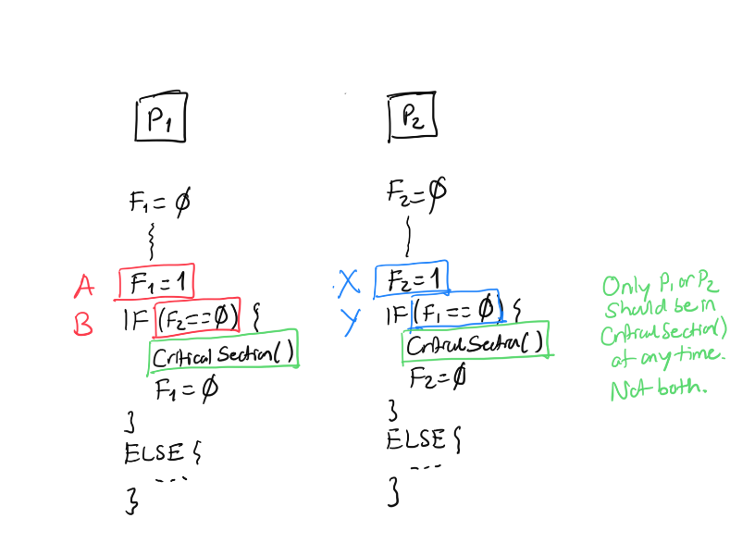
Protecting Shared Data
Assume P1 is in critical section.
Intuitively, it must have executed A,
which means F1 must be 1 (as A happens before B),
which means P2 should not enter the critical section.

Slide 15
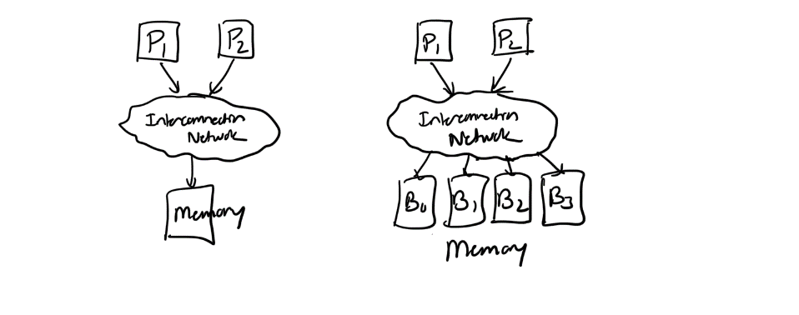
A Critical Question
Can the two processors be in the critical section at the same time given that they both obey the von Neumann model?
Answer: yes

Slide 16
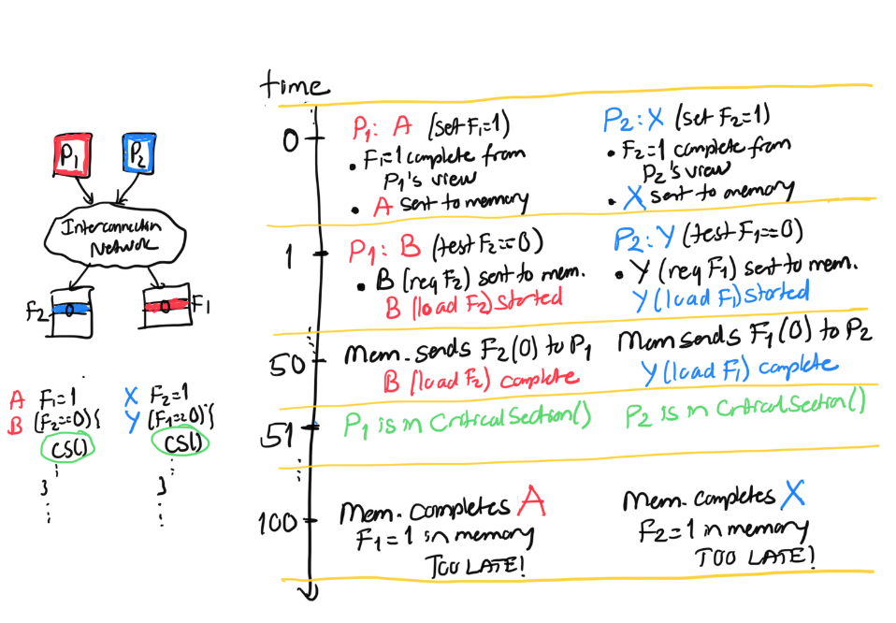
Incorrect Result: Both Processors in Critical Section

Slide 17
What Happened? Let’s Examine Each Processor’s View

Slide 18
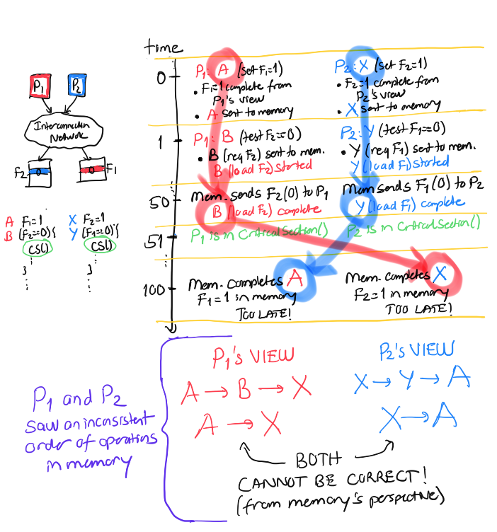
For P1:
A appeared to
happen before X
For P2:
X appeared to
happen before A

Slide 19
The Problem
The two processors did NOT see the same order of operations to memory
The “happened before” relationship between multiple updates to memory was inconsistent between the two processors’ points of view
As a result, each processor thought the other was not in the critical section

Slide 20
How Can We Solve The Problem?
Idea: Sequential consistency
All processors see the same order of operations to memory
i.e., all memory operations happen in an order (called the global total order) that is consistent across all processors
Assumption: within this global order, each processor’s operations appear in sequential order with respect to its own operations.

Slide 21
Sequential Consistency
Lamport, “How to Make a Multiprocessor Computer That Correctly Executes Multiprocess Programs,” IEEE Transactions on Computers, 1979
A multiprocessor system is sequentially consistent if:
the result of any execution is the same as if the operations of all the processors were executed in some sequential order
AND
the operations of each individual processor appear in this sequence in the order specified by its program
This is a memory ordering model, or memory model
Specified by the ISA

Slide 22
Programmer’s Abstraction
Memory is a switch that services one load or store at a time from any processor
All processors see the currently serviced load or store at the same time
Each processor’s operations are serviced in program order
P1
P2
P3
Pn
MEMORY
Notes:
If you satisfy this, this is sequential consistency

Slide 23
Sequentially Consistent Operation Orders
Potential correct global orders (all are correct):
A B X Y
A X B Y
A X Y B
X A B Y
X A Y B
X Y A B
Which order (interleaving) is observed depends on implementation and dynamic latencies
Notes:
This satisfies the requirement, but what’s the problem? Debugging.

Slide 24
Consequences of Sequential Consistency
Corollaries
1. Within the same execution, all processors see the same global order of operations to memory
→ No correctness issue
→ Satisfies the “happened before” intuition
2. Across different executions, different global orders can be observed (each of which is sequentially consistent)
→ Debugging is still difficult (as order changes across runs)

Slide 25
Issues with Sequential Consistency?
Performance enhancement techniques that could make SC implementation difficult
Out-of-order execution
Loads happen out-of-order with respect to each other and with respect to independent stores → makes it difficult for all processors to see the same global order of all memory operations
Caching
A memory location is now present in multiple places
Prevents the effect of a store to be seen by other processors → makes it difficult for all processors to see the same global order of all memory operations

Slide 26
Issues with Sequential Consistency?
Nice abstraction for programming, but two issues:
Too conservative ordering requirements
Limits the aggressiveness of performance enhancement techniques
Is the total global order requirement too strong?
Do we need a global order across all operations and all processors?
How about a global order only across all stores?
Total store order memory model; unique store order model
How about a enforcing a global order only at the boundaries of synchronization?
Relaxed memory models
Acquire-release consistency model

Slide 27
Weaker Memory Consistency
The ordering of operations is important when the order affects operations on shared data → i.e., when processors need to synchronize to execute a “program region”
Weak consistency
Idea: Programmer specifies regions in which memory operations do not need to be ordered
“Memory fence” instructions delineate those regions
All memory operations before a fence must complete before fence is executed
All memory operations after the fence must wait for the fence to complete
Fences complete in program order
All synchronization operations act like a fence

Slide 28
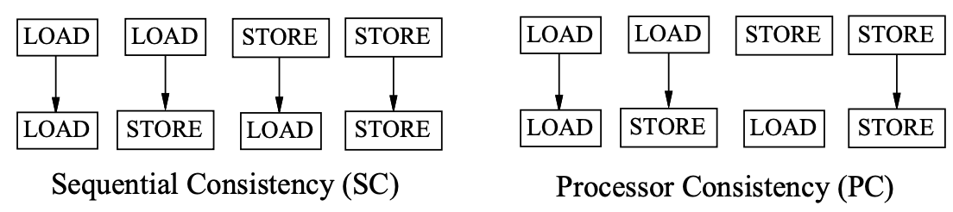
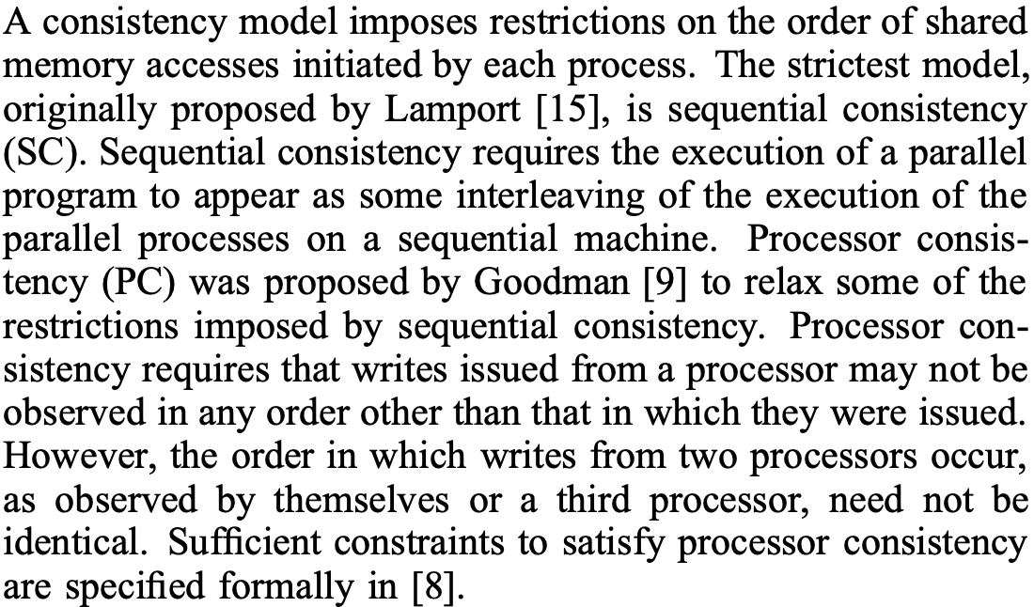
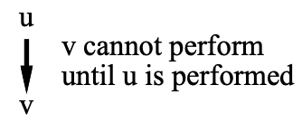
Examples of Weak Consistency Models
Gharachorloo et al., “Two Techniques to Enhance the Performance of Memory Consistency Models,” ICPP 1991.

Slide 29
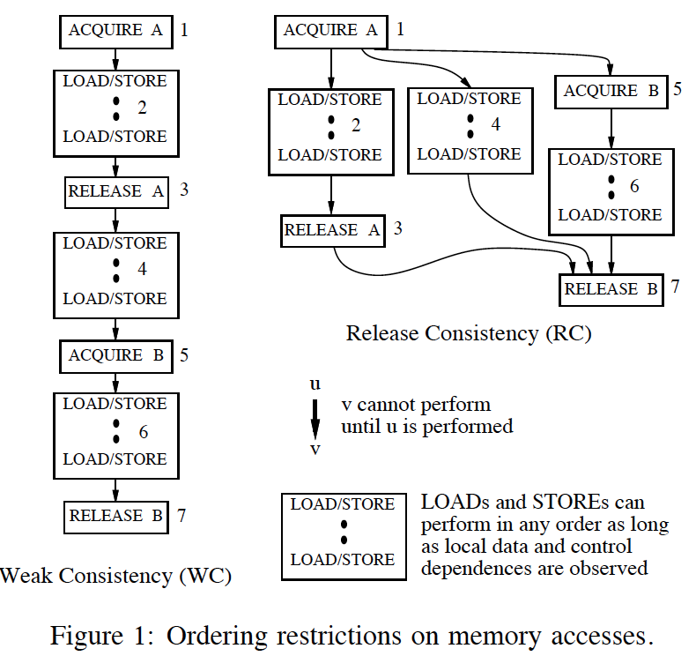
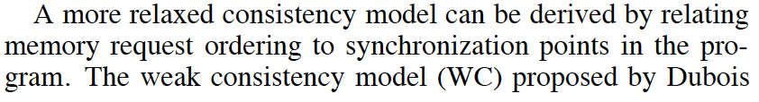
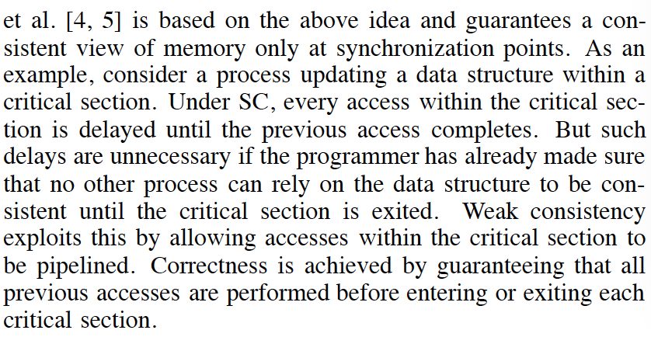
Examples of Weak Consistency Models
Gharachorloo et al., “Two Techniques to Enhance the Performance of Memory Consistency Models,” ICPP 1991.

Slide 30
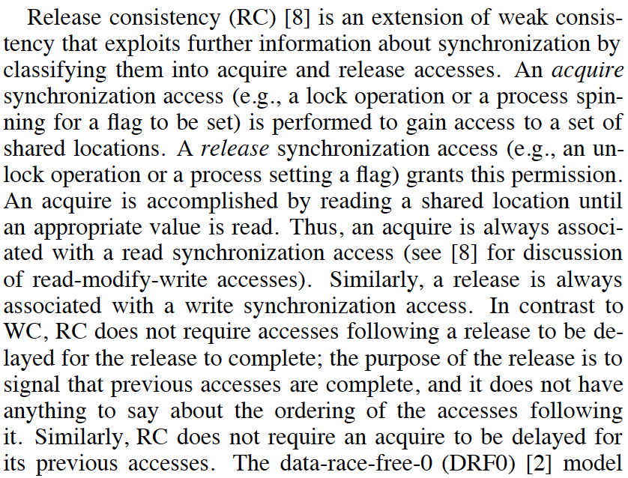
Examples of Weak Consistency Models
Gharachorloo et al., “Two Techniques to Enhance the Performance of Memory Consistency Models,” ICPP 1991.

Slide 31
Tradeoffs: Weaker Consistency
Advantage
No need to guarantee a very strict order of memory operations
→ Enables the hardware implementation of performance enhancement techniques to be simpler
→ Can be higher performance than stricter ordering
Disadvantage
More burden on the programmer or software (need to get the “fences” correct)
Another example of the programmer-microarchitect tradeoff

Slide 32
Example Question I

Slide 33
Example Question I (Continued)

Slide 34
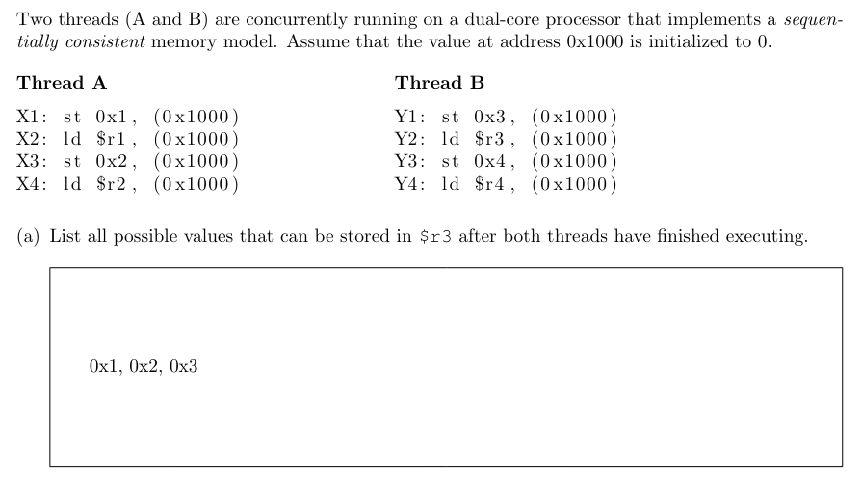
Example Question I - Answer

Slide 35
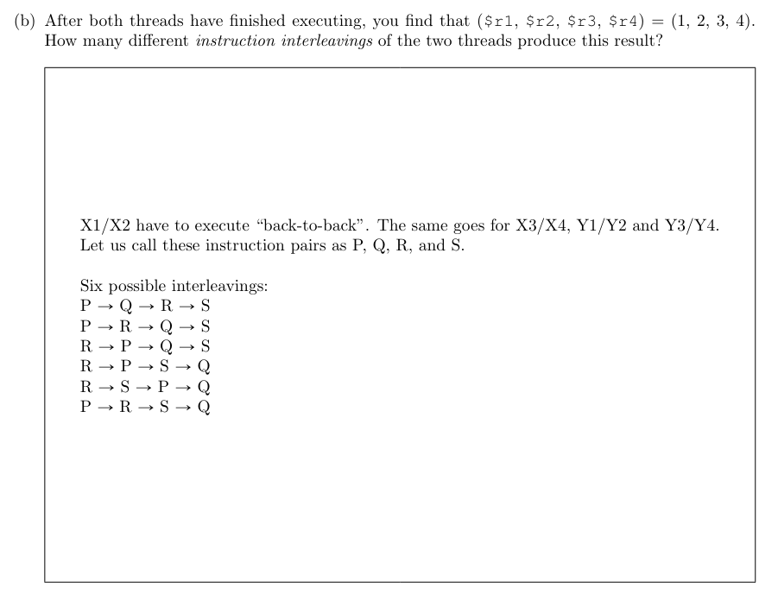
Example Question I - Answer

Slide 36
Example Question I - Answer
Q-c: What is the total number of all possible instruction interleavings? You need not expand factorials
A-c: Eight instructions in total are executed. Among them, you must choose the four that are from Thread A. 8-Choose-4 = 8!/4!/4!.
Q-d: On a non-sequentially consistent processor, is the total number of all possible instruction interleavings less than, equal to, or greater than your answer to question (c)?
A-d: The same. Since all the memory accesses are to the same address, they cannot be reordered more aggressively without affecting the correctness within even a single thread.

Slide 37
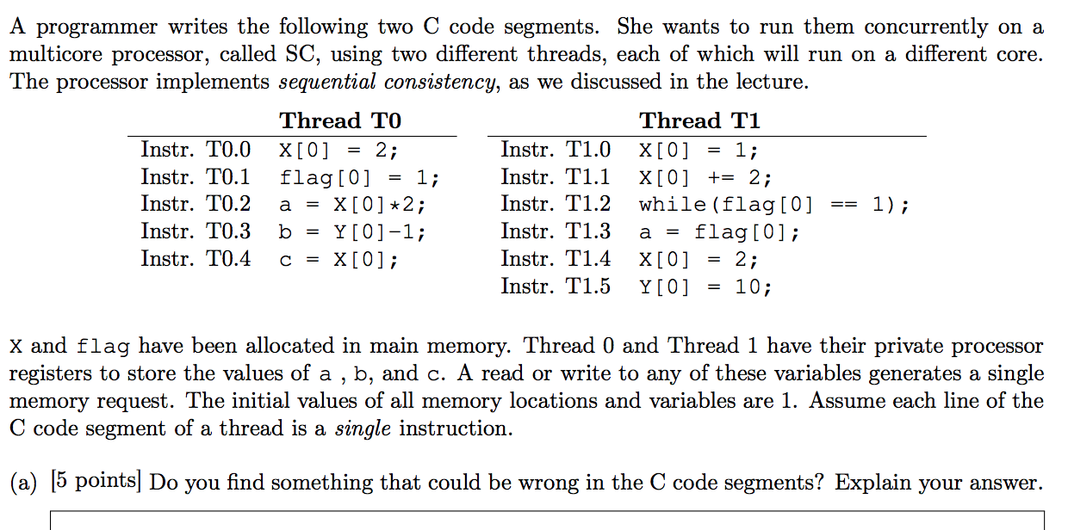
Example Question II

Slide 38
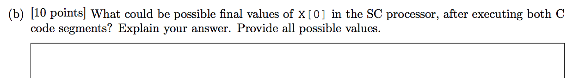
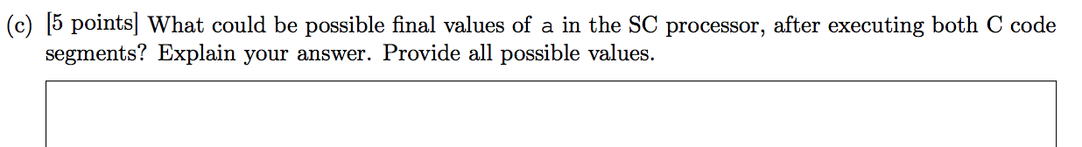
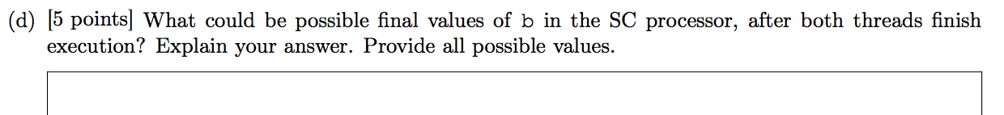
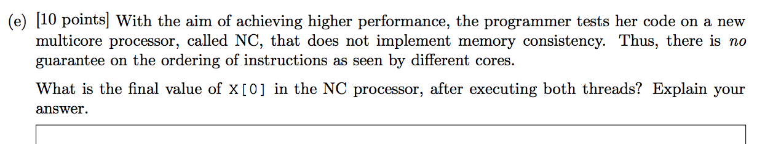
Example Question II (Continued)

Slide 39
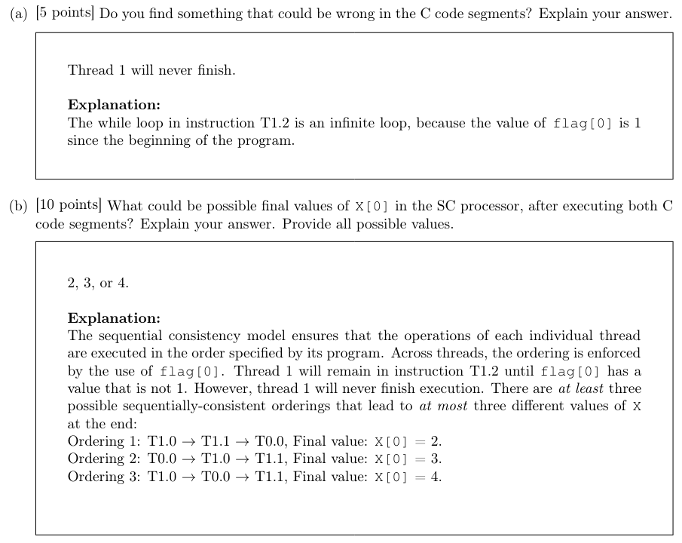
Example Question II-Answers

Slide 40
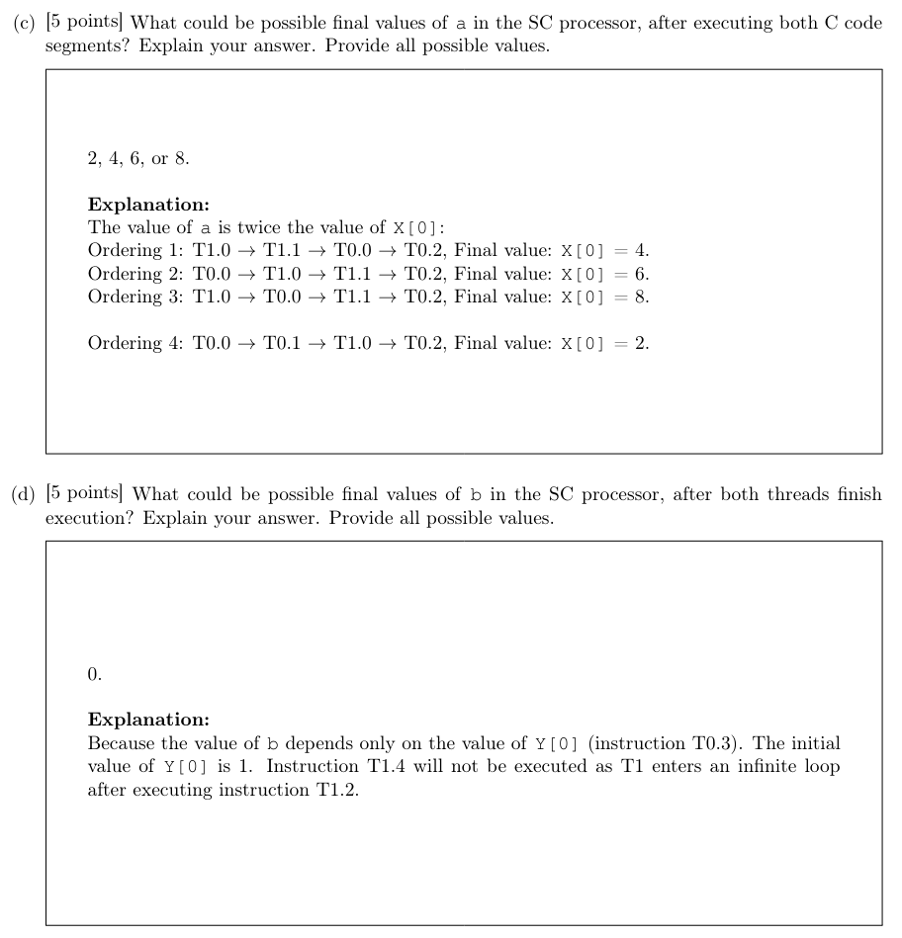
Example Question II-Answers

Slide 41
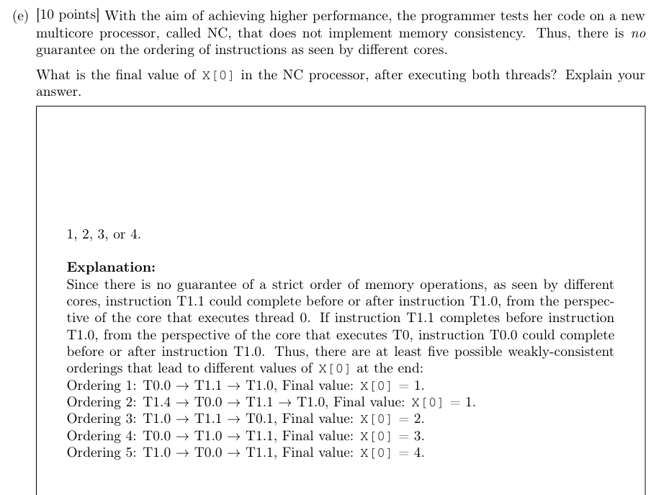
Example Question II-Answers

Slide 42
Participation quiz-3:
List one of the advantages of sequential (memory) consistency and weak (memory) consistency
Note: Justify your reasoning.

Slide 43
Cache Coherence

Slide 44
Shared Memory Model
Many parallel programs communicate through shared memory
Proc 0 writes to an address, followed by Proc 1 reading
This implies communication between the two
Each read should receive the value last written by anyone
This requires synchronization (what does last written mean?)
What if Mem[A] is cached (at either end)?
Proc 0
Mem[A] = 1
Proc 1
…
Print Mem[A]

Slide 45
Cache Coherence
Basic question: If multiple processors cache the same block, how do they ensure they all see a consistent state?
P1
P2
Interconnection Network
1000
x
Main Memory

Slide 46
The Cache Coherence Problem
P1
P2
ld r2, x
1000
Interconnection Network
1000
x
Main Memory

Slide 47
The Cache Coherence Problem
P1
P2
ld r2, x
ld r2, x
1000
1000
Interconnection Network
x
1000
Main Memory

Slide 48
The Cache Coherence Problem
P1
P2
ld r2, x
ld r2, x
add r1, r2, r4
st x, r1
2000
1000
Interconnection Network
1000
x
Main Memory

Slide 49
The Cache Coherence Problem
P1
P2
ld r2, x
ld r2, x
add r1, r2, r4
st x, r1
2000
1000
Should NOT load 1000
ld r5, x
Interconnection Network
1000
x
Main Memory

Slide 50
Cache Coherence: Whose Responsibility?
Software
Can the programmer ensure coherence if caches are invisible to software?
Non-solution: Make shared locks/data non-cacheable (not realistic again)
Coarse-grained: Page-level coherence has huge overhead (not realistic)
Fine-grained: What if the ISA provided a cache flush instruction?
FLUSH-LOCAL A: Flushes/invalidates the cache block containing address A from a processor’s local cache.
FLUSH-GLOBAL A: Flushes/invalidates the cache block containing address A from all other processors’ caches.
FLUSH-CACHE X: Flushes/invalidates all blocks in cache X.
Hardware
Simplifies software’s job
One idea: Invalidate all other copies of block A when a processor writes to it
Notes:
You don’t know what processor and when it performs the write operation.
Race condition associated with FLUSH-GLOBAL A.
FLUSH-GLOBAL A
Store A
What can happen?

Slide 51
A Very Simple Coherence Scheme
Caches “snoop” (observe) each other’s write/read operations. If a processor writes to a block, all others invalidate the block.
A simple protocol:
PrRd/--
PrWr / BusWr
Write-through, no-write-allocate cache
Actions of the local processor on the cache block: PrRd, PrWr,
Actions that are broadcast on the bus for the block: BusRd, BusWr
Valid
BusWr
PrRd / BusRd
Invalid
PrWr / BusWr
Notes:
A write invalidates a cache, because it’s write-through and no write-allocate

Slide 52
Trade-off on Providing Coherence
Coherence schemes typically target a cache line or cache block, not an entire cache or individual data elements within a cache.
Remainder: Cache Line or Block: A cache is divided into small units called cache lines or blocks. Coherence protocols maintain consistency at this level. For example, if a cache line is updated by one processor, coherence protocols ensure that other caches see the updated value or mark their copy as invalid.
Coherence at the Cache Line Level: By focusing on cache lines, coherence schemes can achieve consistency with fine granularity while maintaining efficiency. If coherence were maintained at the level of entire caches, it would be less efficient due to the large amount of unnecessary invalidations or updates. If coherence targeted individual data elements within cache lines, it would add complexity without a significant gain in performance.
Thus, coherence schemes ensure that all processors in a multiprocessor system have a consistent view of data at the level of cache lines or blocks.

Slide 53
(Non-)Solutions to Cache Coherence
No hardware based coherence
Keeping caches coherent is software’s responsibility
+ Makes microarchitect’s life easier
-- Makes average programmer’s life much harder
need to worry about hardware caches to maintain program correctness?
-- Overhead in ensuring coherence in software
All caches are shared between all processors
+ No need for coherence
-- Shared cache becomes the bandwidth bottleneck
-- Very hard to design a scalable system with low-latency cache access this way
Notes:
Cell processor doesn’t have hardware coherence.

Slide 54
Maintaining Coherence
Need to guarantee that all processors see a consistent value (i.e., consistent updates) for the same memory location
Writes to location A by P0 should be seen by P1 (eventually), and all writes to A should appear in some order
Coherence needs to provide:
Write propagation: guarantee that updates will propagate
Write serialization: provide a consistent global order seen by all processors
Need a global point of serialization for this store ordering

Slide 55
Hardware Cache Coherence
Basic idea:
A processor/cache broadcasts its write/update to a memory location to all other processors
Another cache that has the location either updates or invalidates its local copy

Slide 56
Coherence: Update vs. Invalidate
How can we safely update replicated data?
Option 1 (Update protocol): push an update to all copies
Option 2 (Invalidate protocol): ensure there is only one copy (local), update it
On a Read:
If local copy is Invalid, put out request
(If another node has a copy, it returns it, otherwise memory does)

Slide 57
Coherence: Update vs. Invalidate (II)
On a Write:
Read block into cache as before
Update Protocol:
Write to block, and simultaneously broadcast written data and address to sharers
(Other nodes update the data in their caches if block is present)
Invalidate Protocol:
Write to block, and simultaneously broadcast invalidation of address to sharers
(Other nodes invalidate block in their caches if block is present)
Notes:
Which one do you want?

Slide 58
Update vs. Invalidate Tradeoffs
Which do we want?
Write frequency and sharing behavior are critical
Update
+ If sharer set is constant and updates are infrequent, avoids the cost of invalidate-reacquire (broadcast update pattern)
- If data is rewritten without intervening reads by other cores, updates were useless
- Write-through cache policy ➔ bus becomes bottleneck
Invalidate
+ After invalidation broadcast, core has exclusive access rights
+ Only cores that keep reading after each write retain a copy
- If write contention is high, leads to ping-ponging (rapid mutual invalidation-reacquire)
Notes:
Talk about false sharing here to explain the ping-pong.

Slide 59
Two Cache Coherence Methods
How do we ensure that the proper caches are updated?
Snoopy Bus [Goodman ISCA 1983, Papamarcos+ ISCA 1984]
Bus-based, single point of serialization for all memory requests
Processors observe other processors’ actions
E.g.: P1 makes “read-exclusive” request for A on bus, P0 sees this and invalidates its own copy of A
Directory [Censier and Feautrier, IEEE ToC 1978]
Single point of serialization per block, distributed among nodes
Processors make explicit requests for blocks
Directory tracks which caches have each block
Directory coordinates invalidation and updates
E.g.: P1 asks directory for exclusive copy, directory asks P0 to invalidate, waits for ACK, then responds to P1
Notes:
The directory-based solution is more scalable because you need a directory for one cache block.

Slide 60
Snoopy Cache Coherence

Slide 61
Snoopy Cache Coherence
Idea:
All caches “snoop” all other caches’ read/write requests and keep the cache block coherent
Each cache block has “coherence metadata” associated with it in the tag store of each cache
Easy to implement if all caches share a common bus
Each cache broadcasts its read/write operations on the bus
Good for small-scale multiprocessors
What if you would like to have a 1000-node multiprocessor?

Slide 62
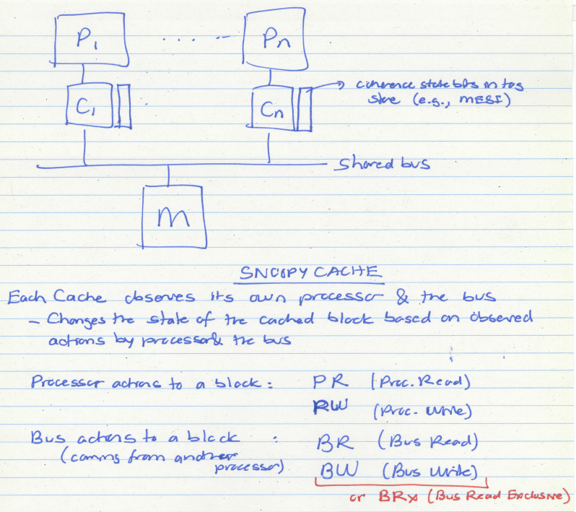

Slide 63
A Simple Snoopy Cache Coherence Protocol
Caches “snoop” (observe) each other’s write/read operations
A simple protocol:
PrRd/--
PrWr / BusWr
Write-through, no-write-allocate cache
Actions of the local processor on the cache block: PrRd, PrWr,
Actions that are broadcast on the bus for the block: BusRd, BusWr
Valid
BusWr
PrRd / BusRd
Invalid
PrWr / BusWr
Notes:
No exclusive access state. Always needs to send invalidation for every write even if it has the only copy.

Slide 64
A More Sophisticated Protocol: MSI
Extend metadata per block to encode three states:
M(odified): cache line is the only cached copy and is dirty
S(hared): cache line is potentially one of several cached copies
I(nvalid): cache line is not present in this cache
Read miss makes a Read request on bus, transitions to S
Write miss makes a ReadEx request, transitions to M state
When a processor snoops ReadEx from another writer, it must invalidate its own copy (if any)
S→M upgrade can be made without re-reading data from memory (via Invalidations)
Notes:
Give an example:
S = 00
M = 01
I = 11

Slide 65
MSI State Machine
M
BusRd/Flush
PrWr/BusRdX
PrWr/BusRdX
PrRd/--
PrWr/--
BusRdX/Flush
PrRd/BusRd
S
I
PrRd/--
BusRd/--
BusRdX/--
ObservedEvent/Action
Notes:
From invalid to shared, a processor reads a cache line. Even if only one processor owns the cache block, it needs to send BusRdx

Slide 66
The Problem with MSI
A block is in no cache to begin with
Problem: On a read, the block immediately goes to “Shared” state although it may be the only copy to be cached (i.e., no other processor will cache it)
Why is this a problem?
Suppose the cache that read the block wants to write to it at some point
It needs to broadcast “invalidate” even though it has the only cached copy!
If the cache knew it had the only cached copy in the system, it could have written to the block without notifying any other cache → saves unnecessary broadcasts of invalidations

Slide 67
The Solution: MESI
Idea: Add another state indicating that this is the only cached copy and it is clean.
Exclusive state
Block is placed into the exclusive state if, during BusRd, no other cache had it
Snooping caches assert the signal if they also have a copy
Silent transition Exclusive→Modified is possible on write!
MESI is also called the Illinois protocol
Papamarcos and Patel, “A low-overhead coherence solution for multiprocessors with private cache memories,” ISCA 1984.
Notes:
If some processor has a valid copy, enter the shared state.

Slide 68
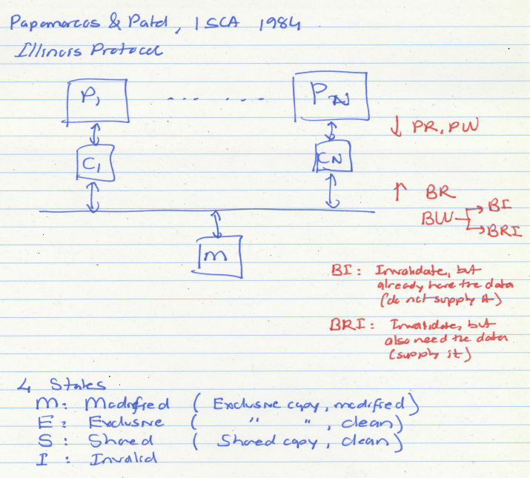

Slide 69
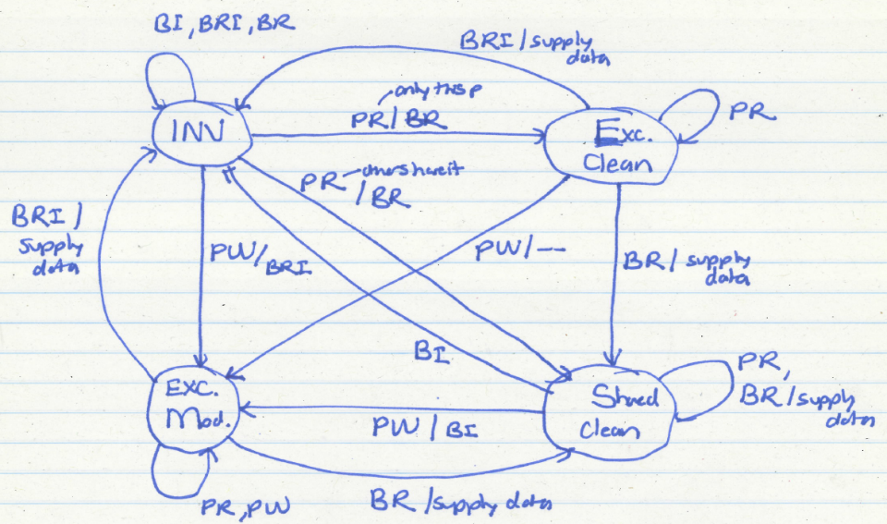
MESI State Machine

Slide 70
MESI State Machine
M
PrWr/--
BusRd/Flush
PrWr/BusRdX
E
BusRd/ $ Transfer
PrWr/BusRdX
S
PrRd (S’)/BusRd
PrRd (S)/BusRd
I
BusRdX/Flush (all incoming)

Slide 71
The Problem with MESI
Observation: Shared state requires the data to be clean
i.e., all caches that have the block have the up-to-date copy and so does the memory
Problem: Need to write the block to memory when BusRd happens when the block is in Modified state
Why is this a problem?
Memory can be updated unnecessarily → some other processor may want to write to the block again

Slide 72
Improving on MESI
Idea 1: Do not transition from M→S on a BusRd. Invalidate the copy and supply the modified block to the requesting processor directly without updating memory
Idea 2: Transition from M→S, but designate one cache as the owner (O), who will write the block back when it is evicted
Now “Shared” means “Shared and potentially dirty”
This is a version of the MOESI protocol
Notes:
The first idea means that the requesting processor goes to M state. What if the other processor wants to read again?
The second idea means that the requesting processor goes to O state.

Slide 73
Participation quiz-4:
A cache coherence scheme may target
a data
a cache line (or block)
the whole cache
Which one of these three is more reasonable and performs better in general?

Slide 74
Directory Based Cache Coherence

Slide 75
Directory Based Coherence
Idea: A logically-central directory keeps track of where the copies of each cache block reside. Caches consult this directory to ensure coherence.
An example mechanism:
For each cache block in memory, store P+1 bits in directory
One bit for each cache, indicating whether the block is in cache
Exclusive bit: indicates that a cache has the only copy of the block and can update it without notifying others
On a read: set the cache’s bit and arrange the supply of data
On a write: invalidate all caches that have the block and reset their bits
Have an “exclusive bit” associated with each block in each cache (so that the cache can update the exclusive block silently)
Notes:
Serialization for each block -> scalable
When writing a cache, enter the readExclusive state.
Example:
P0 read A 10000
P3 read A 10010
P3 writes A 00011
P1 writes A 01001
P0 reads A 11000

Slide 76
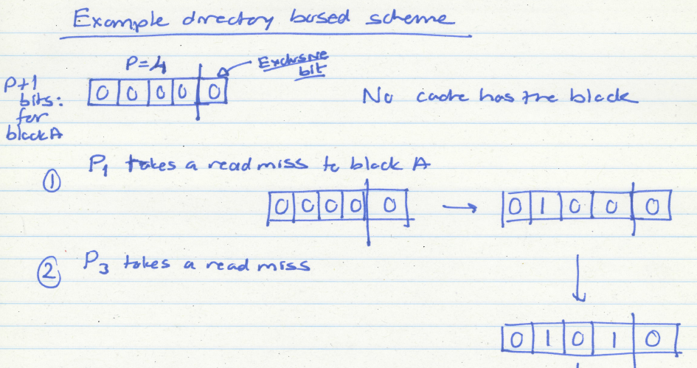
Directory Based Coherence Example (I)

Slide 77
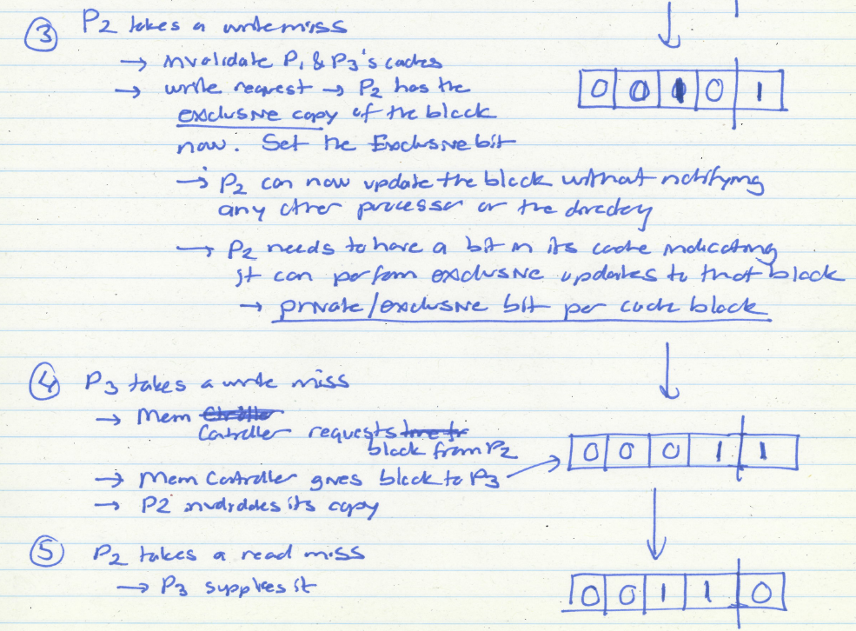
Directory Based Coherence Example (I)

Slide 78
Snoopy Cache vs. Directory Coherence
Snoopy Cache
+ Miss latency (critical path) is short: request → bus transaction to mem.
+ Global serialization is easy: bus provides this already (arbitration)
+ Simple: can adapt bus-based uniprocessors easily
- Relies on broadcast messages to be seen by all caches (in same order):
→ single point of serialization (bus): not scalable
→ need a virtual bus (or a totally-ordered interconnect)
Directory
- Adds indirection to miss latency (critical path): request → dir. → mem.
- Requires extra storage space to track sharer sets
Can be approximate (false positives are OK)
- Protocols and race conditions are more complex (for high-performance)
+ Does not require broadcast to all caches
+ Exactly as scalable as interconnect and directory storage (much more scalable than bus)
Notes:
Make reference to SGI Origin paper

Slide 79
False Sharing

Slide 80
Parallelism: Expectation is awesome
Parallel Program
■ Expectation
int count[8];
int W;
void increment(int S)
{
for(in=S; in<S+W; in++)
for(j=0; j<1M; j++)
count[in]++;
}
int main(int THREADS) {
W=8/THREADS;
for(i=0; i<8; i+=W)
spawn(increment,i);
}
Runtime (s)

Slide 81
Reality is awful
Parallel Program
■ Reality
■ Expectation
int count[8];
int W;
void increment(int S)
{
for(in=S; in<S+W; in++)
for(j=0; j<1M; j++)
count[in]++;
}
int main(int THREADS) {
W=8/THREADS;
for(i=0; i<8; i+=W)
spawn(increment,i);
}
False sharing
Runtime (s)
False sharing slows the program by 13X

Slide 82
False Sharing Causes Performance Problems
Core 1
Core 2
Thread 1
Thread 2
Invalidate
Cache
Cache
Main Memory
Cache line: basic unit of data transfer

Slide 83
False Sharing Causes Performance Problems
Core 1
Core 2
Thread 1
Thread 2
Invalidate
Cache
Cache
Main Memory
Interleaved accesses cause cache invalidations

